Slide 1

SalesInsights - Data Analysis Project using Tableau
By – Lingareddy Tejaswar Reddy
github.com/tejaswar2004

Slide 2
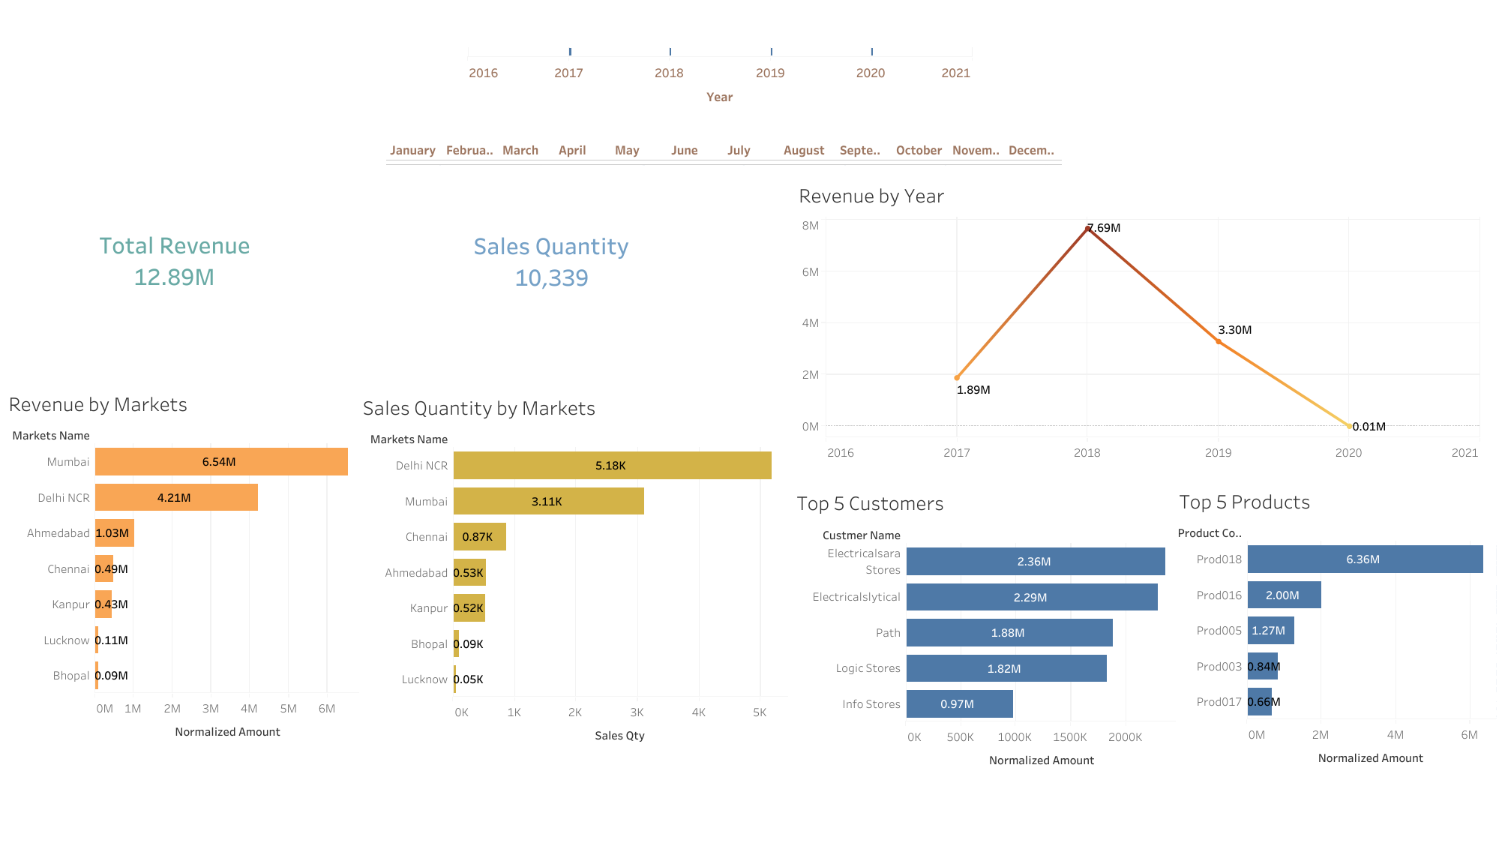

Slide 3
